Slide 1

Smart Hospital Bed
Graduation Project!
2017/2018
Notes:
To use this title animation slide with a new image simply 1) move the top semi-transparent shape to the side, 2) delete placeholder image, 3) click on the picture icon to add a new picture, 4) Move semi-transparent shape back to original position, 5) Update text on slide.

Slide 2
“IT TAKES BOTH SIDE TO BUILD – A BRIDGE .”
— FREADREK NAEL
“A GOAL WITHOUT A PLAN IS – A WISH.”
— Antoine de Saint

Slide 3
INTRODUCTION
Our Team
Alaa Arab – Team Leader & Developer.
Fahed Shtaiwi – System Analyst & Developer.
Ghada aljibouri – Designer & Developer.
Hamzeh Mahmoud – Project Manager &Developer.
Let us have some faith that we are able to accomplish great thing.
Learn to accomplish great things and serve people who is in need that’s what our prophet Mohammed –peace be upon him- ordered us.
University of Petra.
Second Semester.
Supervised by:
Dr. Izzeddin Mattar.

Slide 4
OVERVIEW
Project problem Overview.
“Transferring patient to another bed”
The most dangerous threats to an injured person is unnecessary movement. Moving an injured person can cause additional injury and pain.
“Moving the bed from Room to another”
Despite the huge number of nurses in hospital, but it still not adequate. Where the process of moving bed required at least 3 persons, in some cases other may be busy.
“Human's, Error”
Humans do mistakes in the smallest actions they takes .

Slide 5
Existing Systems Current System
Current and Existing
Systems
#1 hospital bed – Hadramoot team Raspberry & windows 10.
#2 Flexbed – Chao wang, Andrey Savkin, Ray clout IEEE Team
Normal hospital bed – England 1815 - 1874

Slide 6
PROJECT OBJECTVES
1
2
3
4
5
provide convenience hospital employees.
Reduce switching process.
Fast and safe transportation of critical neurosurgery patients.
Improve medicine services.
Provide comfort to the hospitalized patient and Reduce human error.
Reference : The basics you can find anywhere 5 Steps To Successful Storytelling Published on April 5, 2014 Featured in: Marketing & Advertising

Slide 7
ONE OF THE MOST IMPORTANT PHASE IN PROJECT LIFE CYCLE.
planning
“A goal without a plan is a wish ”
— Antoine de Saint

Slide 8

1
PROJECT PROCESS MODEL
Scrum
- Sprint
- Scrum master
- Daily scrum
SOFTWARE PROCESS MODEL
Spiral -Barry Boehm in his 1986
Risk driven

Slide 9
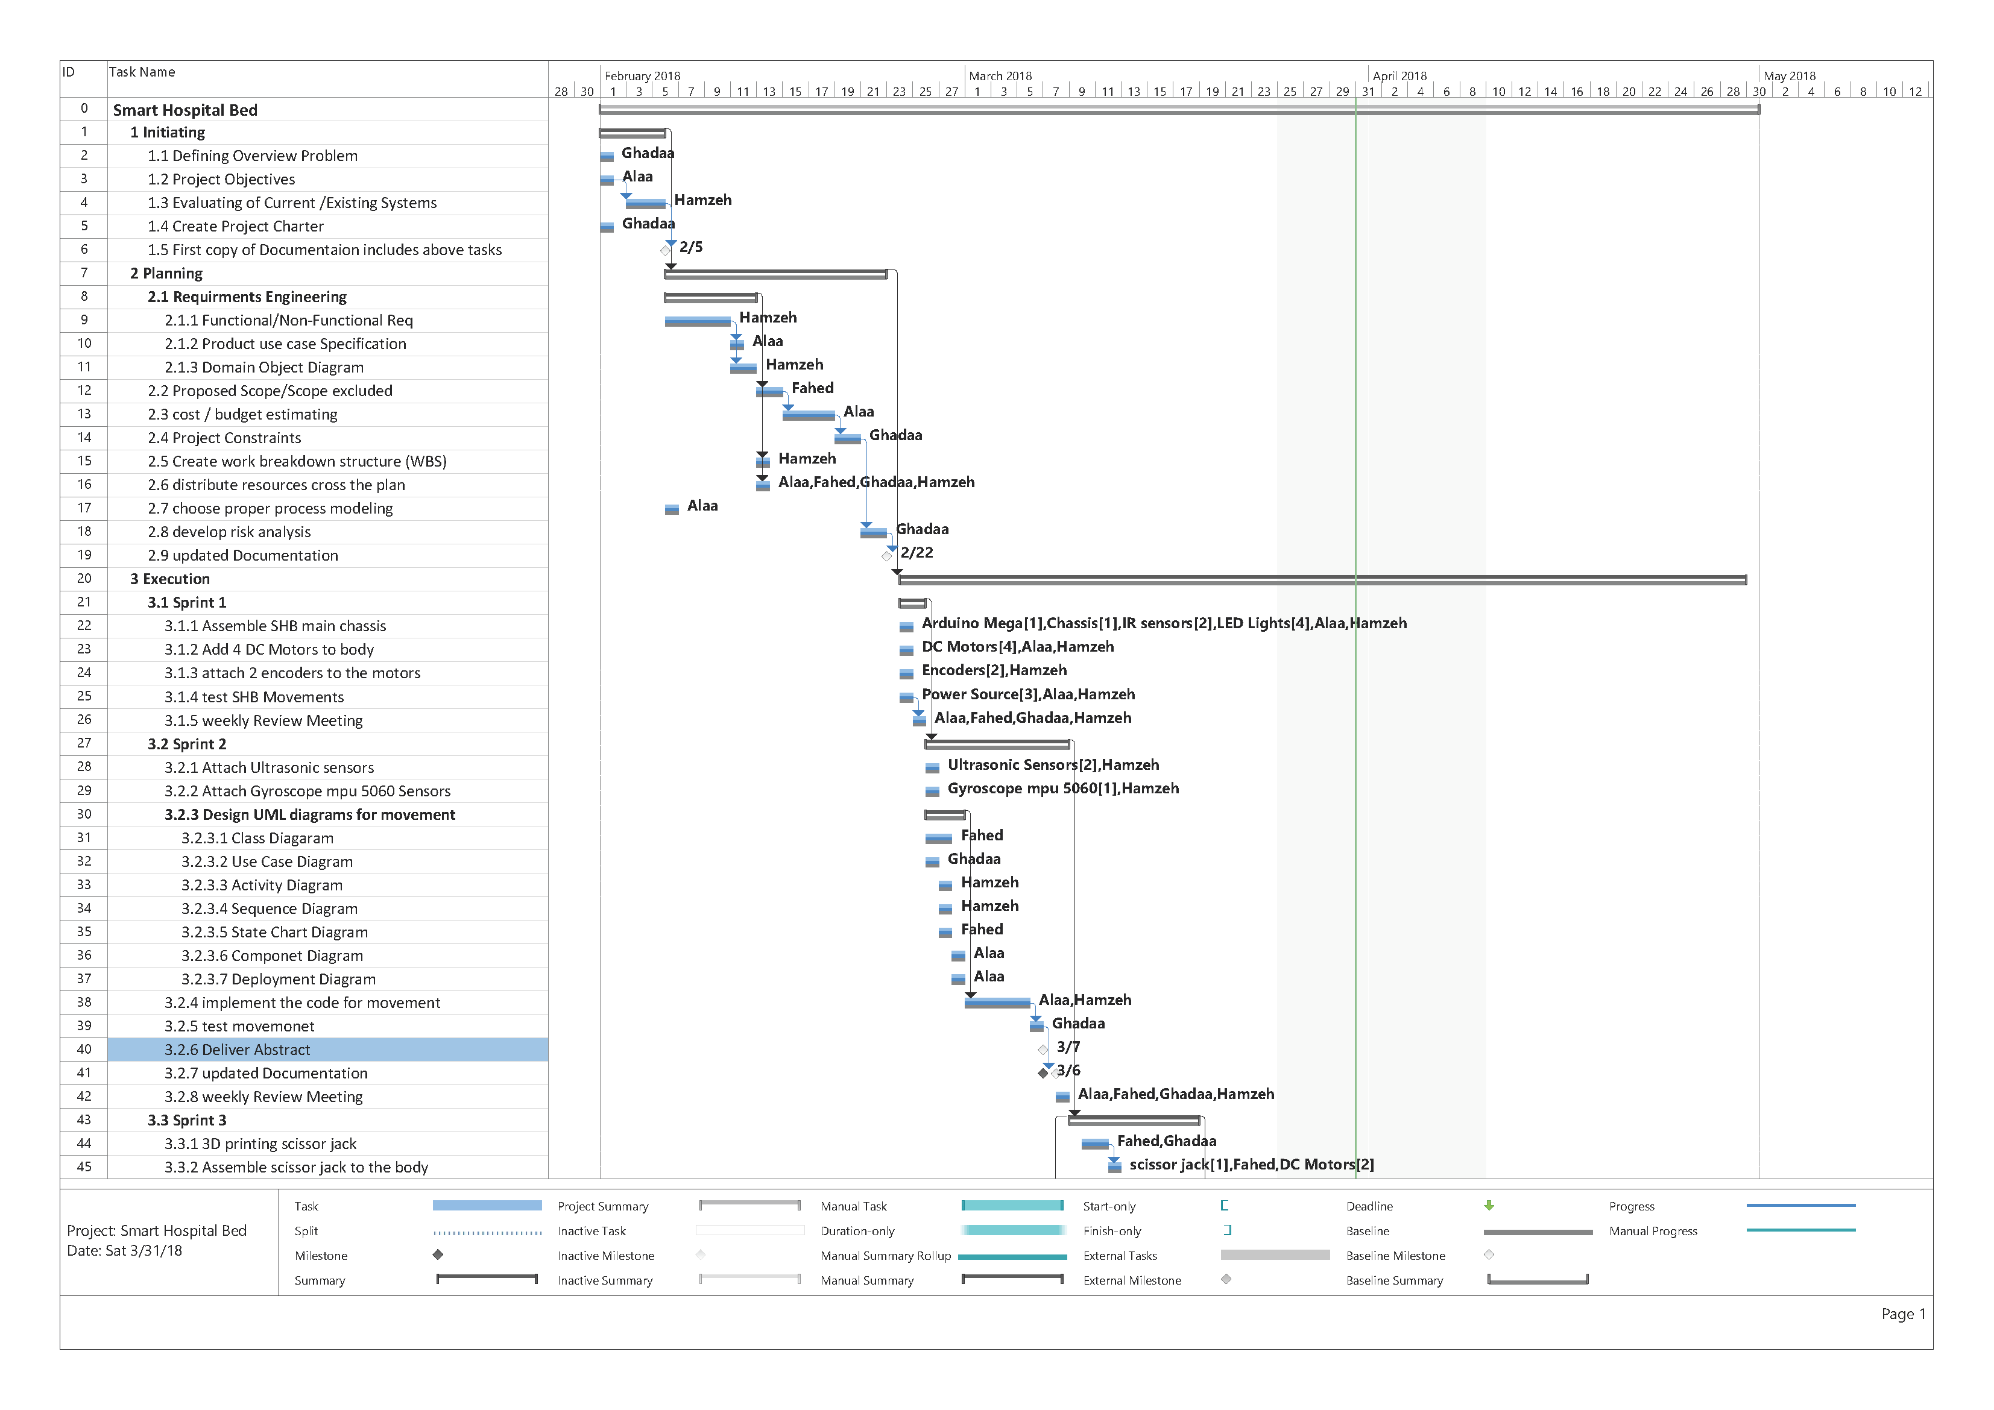
2
Timeline that defines the
Progress of the project
GANTT CHART
Who | What | Where | When

Slide 10

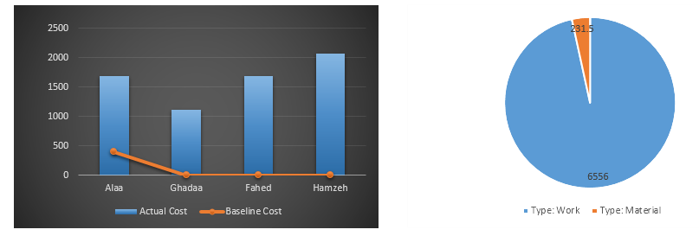
3
Cost & budget
Too many factors can effect the cost of project and it’s really a challenge for the project manager .
6556 Cost for Salaries
231 Hardware
Notes:
Tip:
When using complex image as full-bleed background add a transparency (70%-90%) fill layer to give contrast to text.

Slide 11
EACH PROCESS IN THE SYSTE SHALL FOLLOW A PREDEFINE STRUCTURE.
Analysis &
Design
“A goal without a plan is a wish ”
— Antoine de Saint

Slide 12
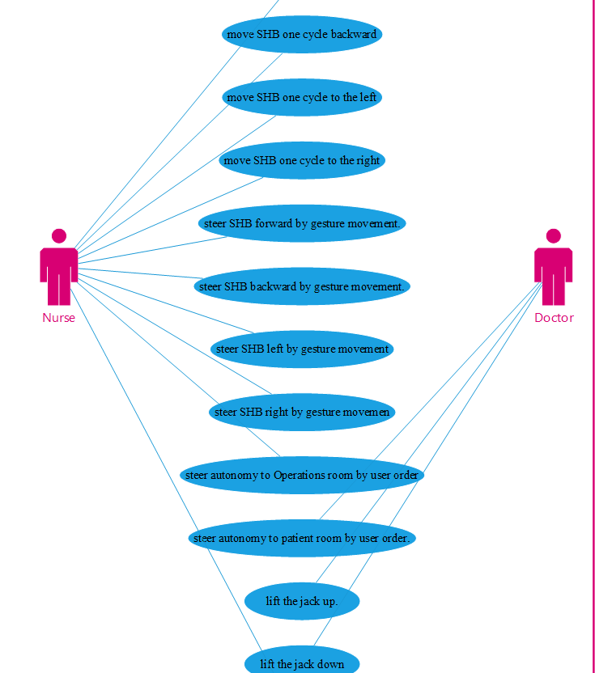
4
Show, don’t tell
Use Case
Visualize diagram
That shows the functions of the system…
And the user who can benefit from it

Slide 13
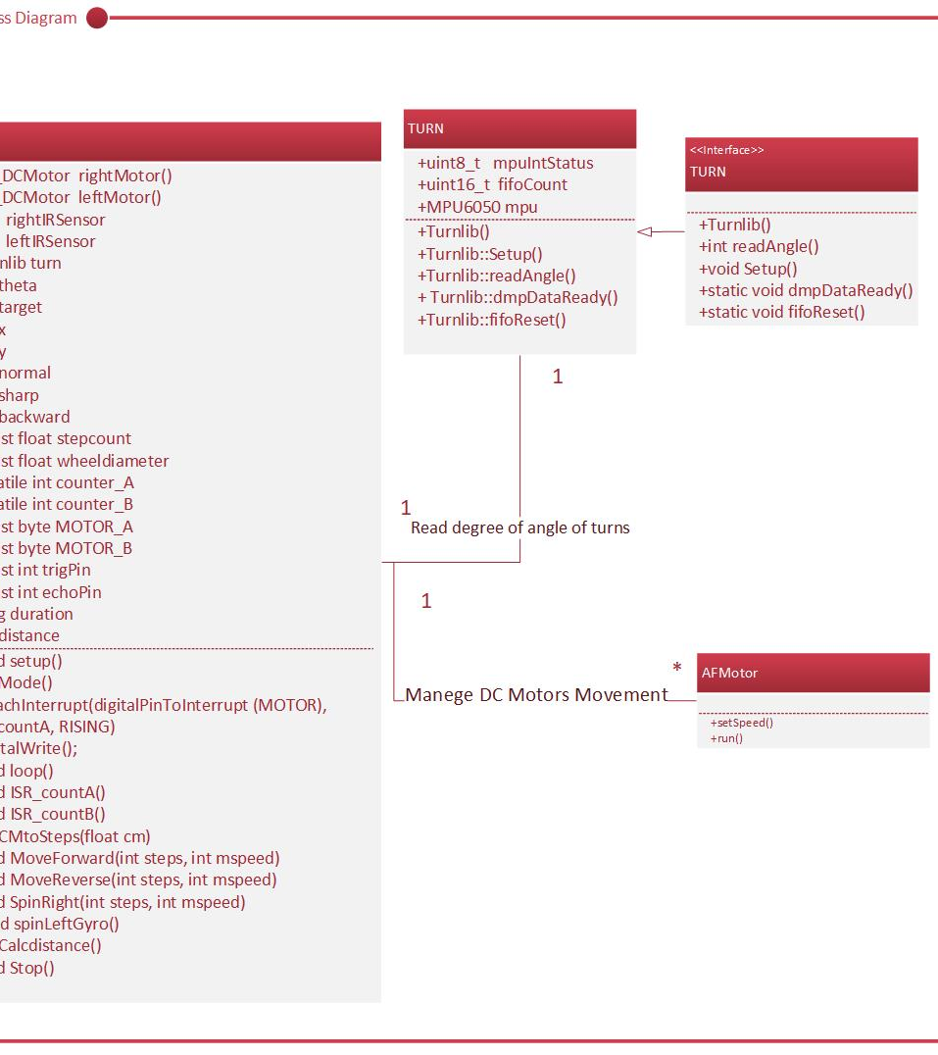
5
Object Oriented Approach
CLASS DIAGRAM
The main attribute and functions associated
To each class.

Slide 14
STARTING TO WRITE CODES AND TAKE ACTIONS.
implementation
“Without hard work, nothing grows but weeds.”
— Gordon B. Hinckley

Slide 15
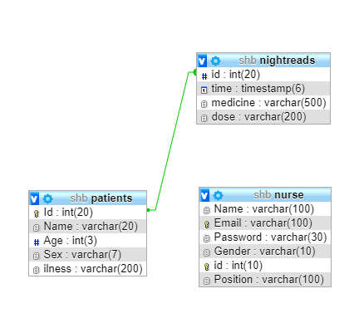
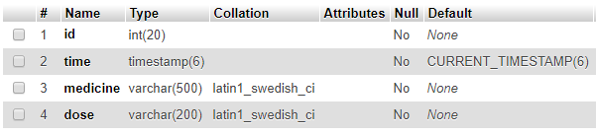
6
How the data is being stored in the database
Database mapping & table description
Attribute for each column in the database

Slide 16
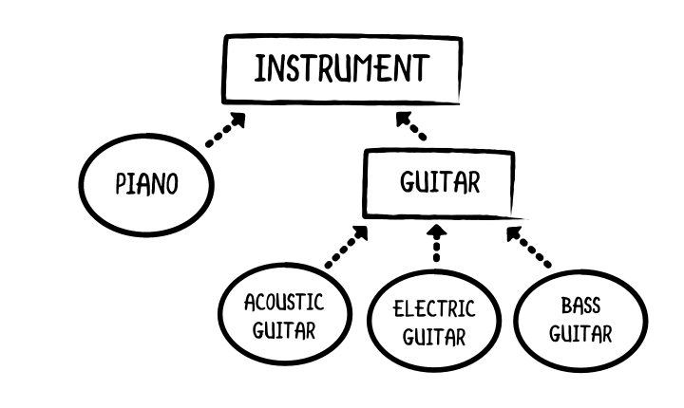
Architecture
Object Oriented.
Layered architectural style
Notes:
Combine an image and multiple key statements with a strong grid.

Slide 17
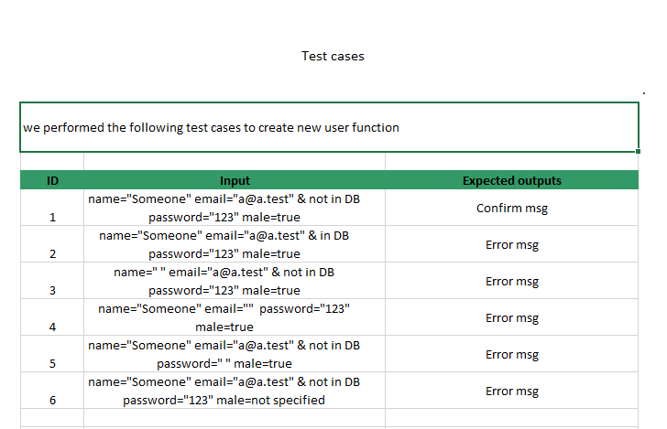
TEST CASES
Insure the correctness of the code.
Notes:
Combine an image and multiple key statements with a strong grid.

Slide 18
BECAUSE OUR WORLD
KEEP SPINING AND KNOWLEDGE
KEEP GROWING,WE HAVE TO LEARN AND EMPLOYE
THE KNOWLEDGE INOREDER TO RISE AND
THE MESSAGE OF HUMANITY.
—SMARTHB TEAM

Slide 19
SMART HOSPITAL BED!
THANK YOU

Slide 20


